Slide 1

E-Commerce Insights: A Sales Predicting Project Using Machine Learning
Data science project 3 - Oeson
By Hissah Alotaibi

Slide 2
Objectives
Conducting exploratory data analysis (EDA) to understand consumer behaviour on retail websites.
Conduct a study on customer online behaviour and its relationship with product purchases by utilizing visualizations to communicate insights effectively
Developing predictive machine learning models to predict whether the consumer will purchase or not based on her/his interactions on the website

Slide 3
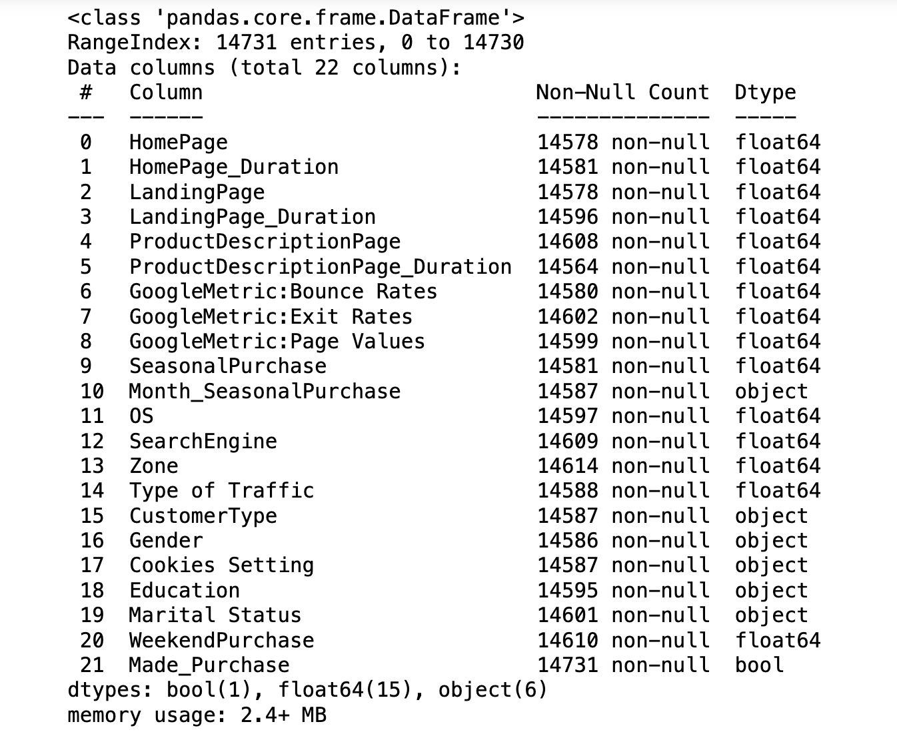
Dataset
The data set from a reputed retail website includes relevant information on consumer behaviour through website engagement for multiple product purchases.
As shown in the figure, the dataset consists of 9 columns and 14731 rows

Slide 4
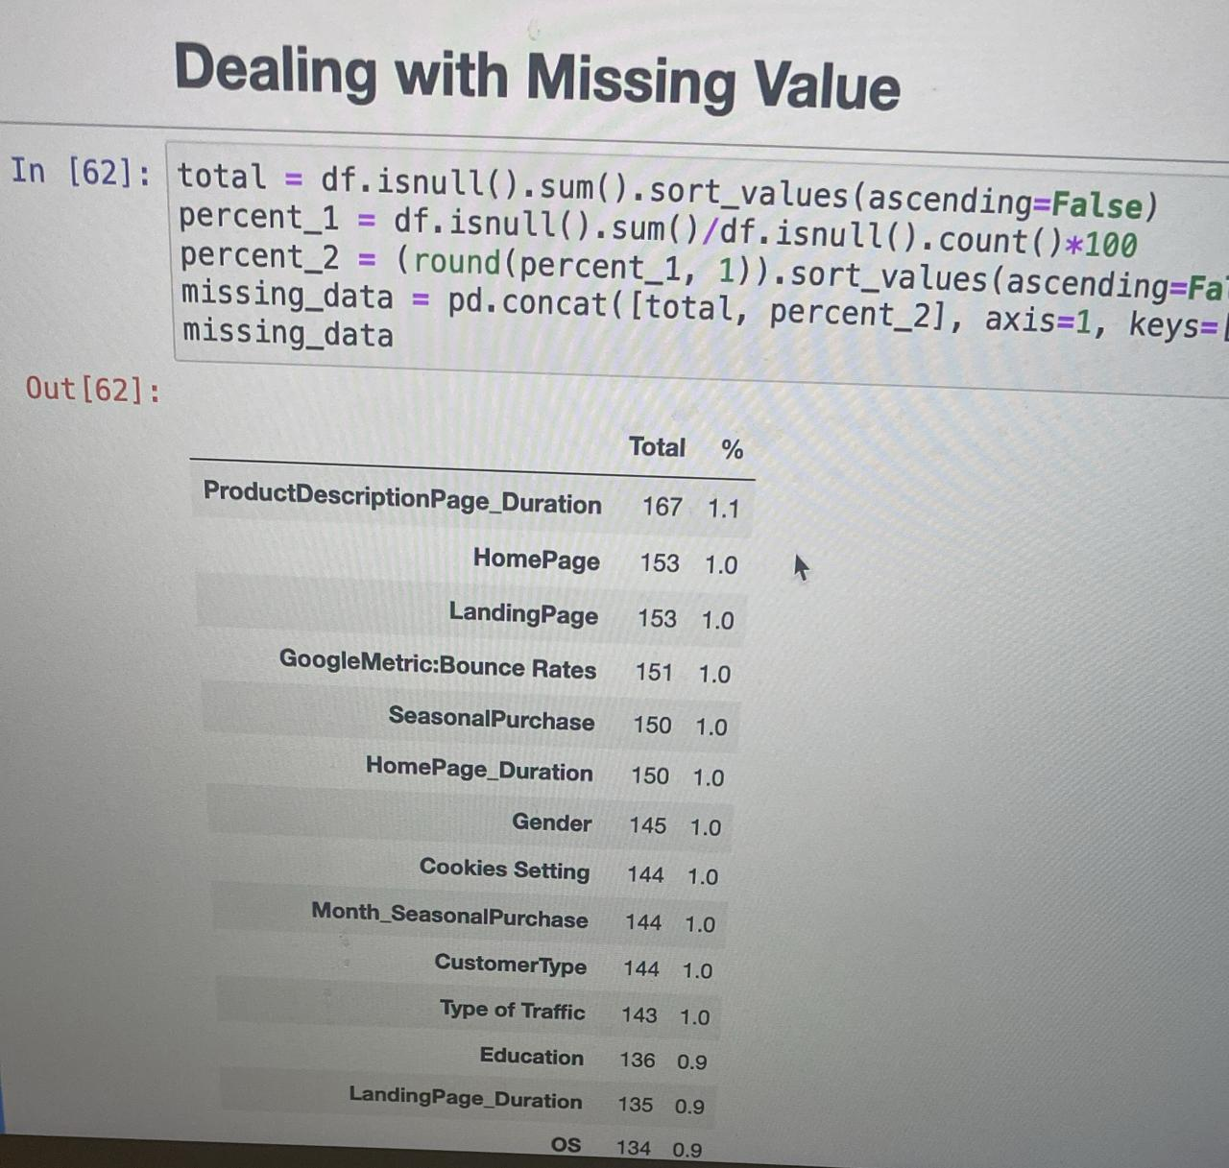
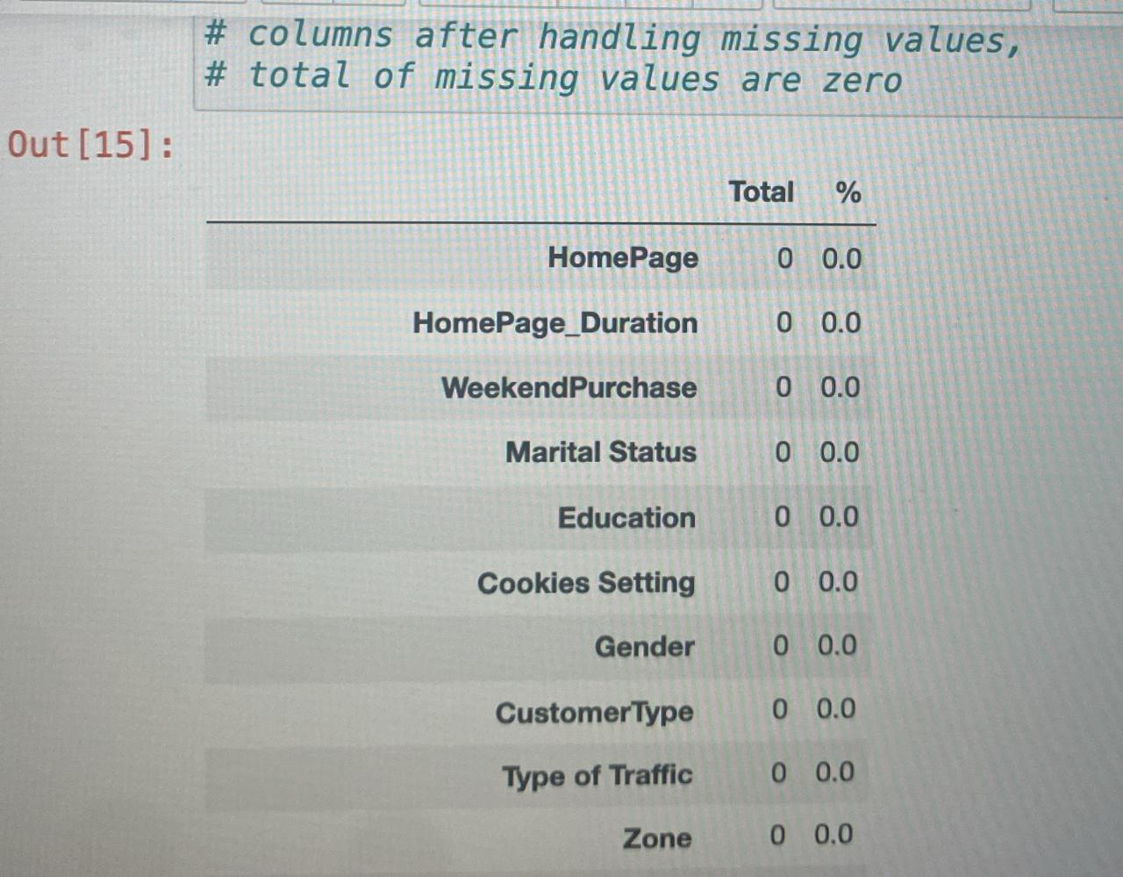
Exploratory Data Analysis
Dealing with missing value
We used isnull().sum() method to check how many values in features are missing
As shown in the figure there are several missing values in the columns
Therefore, to handle these missing values, we used the interpolate linear method to fill numerical values and fillna (df[’column_name'].mode() to fill categorical values.

Slide 5
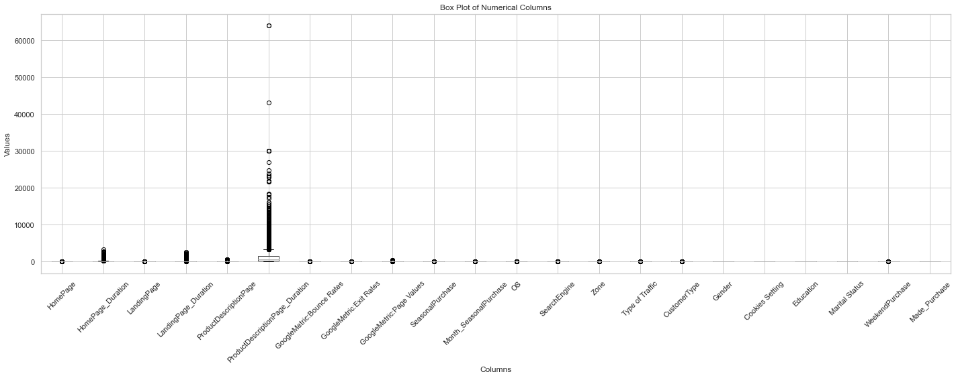
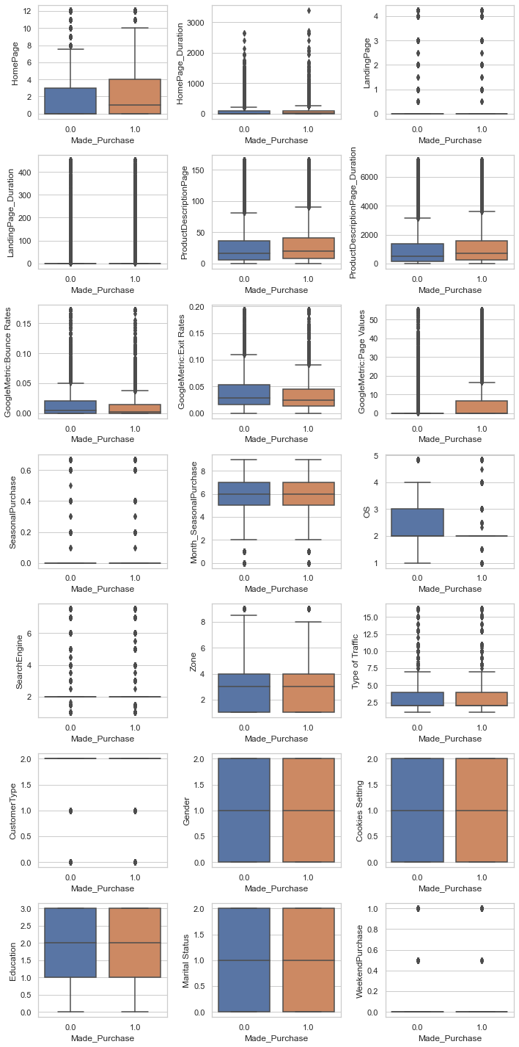
Exploratory Data Analysis
Outlier detection
Box plots were employed to identify outliers in the dataset. Each numerical column was plotted separately against the ‘made_purchedase’ variable (Target variable).
Outlier Treatment
Outliers comprising 3925 records were managed via the z-score method. Rather than removing them outright which might distort the dataset’s distribution, outlier values were replaced. Categorical column outliers with the mode and numerical column outliers were substituted with the medium. This preserved dataset integrity while reducing outlier impact on subsequent analysis.

Slide 6
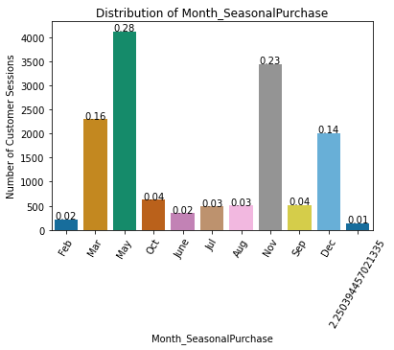
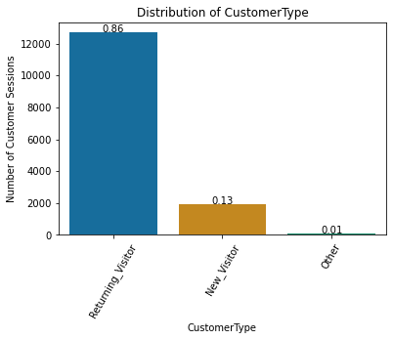
Distributions of Categorical Variables
Most customers shop in May and November. Also, the most of customers are returning customers. Most of them do not purchase anything and are on the website to shop.

Slide 7
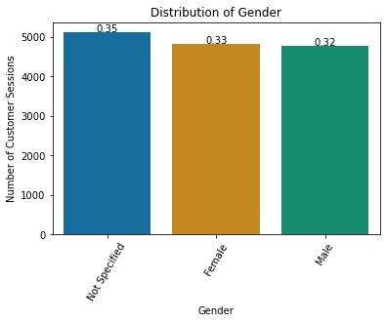
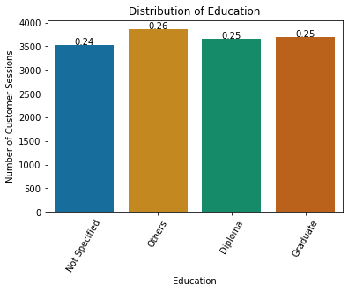
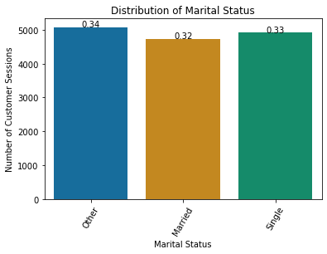
Distributions of Categorical Variables
The figures indicate that there are no differences between levels of education, gender and material status of customers on their interaction on the website.

Slide 8
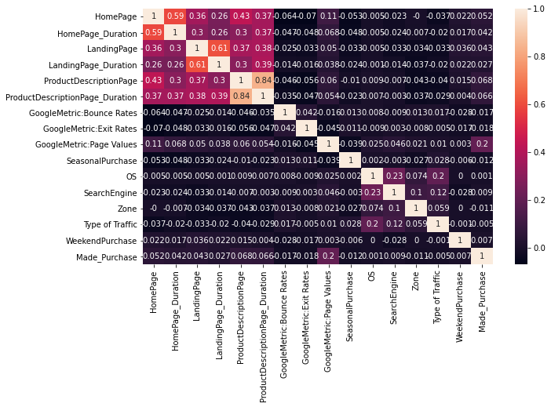
Correlation Analysis
The heatmap is generated to visualize the correlation between different numerical variables in the dataset.
”ProductDescriptionPage_Duration” Show the highest correlation(0.84) with “ProductDescriptionPage”, indicating a robust positive relationship.
Moderately strong positive correlations are observed between “LandingPage_Duration” and “LandingPage” (0.61).
Weaker correlations include “HomePage” with “GoogleMetric: Bounce Rate” (-0.064). These insights shed light on underlying patterns within the dataset.

Slide 9
Exploratory Data Analysis
Marital Status | WeekendPurchase | Made_Purchase
2 | 0 | 0
2 | 1 | 0
1 | 0 | 0
3 | 1 | 0
3 | 0 | 0
2 | 0 | 0
3 | 0 | 0
1 | 0 | 0
1 | 0 | 0
2 | 0 | 0
1 | 0 | 0
1 | 1 | 0
3 | 0 | 0
3 | 0 | 0
3 | 1 | 0
1 | 0 | 0
Categorical Encoding
Label encoding was used to change categorical data, which is challenging to understand for algorithms, to a numerical format
Syntax:
from sklearn.preprocessing import LabelEncoder
label_encoder = LabelEncoder()
data[column_name]= label_encoder.fit_transform(data[column_name])
Marital Status | WeekendPurchase | Made_Purchase
Married | 0 | FALSE
Married | 1 | FALSE
Single | 0 | FALSE
Other | 1 | FALSE
Other | 0 | FALSE
Married | 0 | FALSE
Other | 0 | FALSE
Single | 0 | FALSE
Single | 0 | FALSE
Married | 0 | FALSE
Single | 0 | FALSE
Single | 1 | FALSE
Other | 0 | FALSE
Other | 0 | FALSE

Slide 10
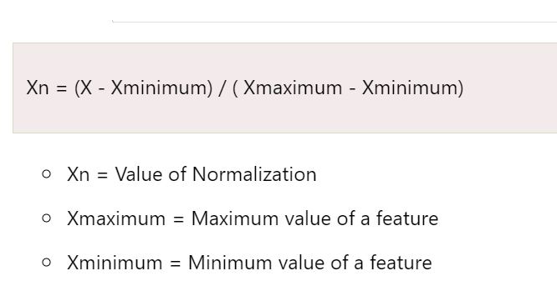
Feature Scaling
To normalize the machine learning model, values are shifted and rescaled so their range can vary between 0 and 1.
We used the Min-Max scaling method to normalize data because our data are not normally distributed.

Slide 11
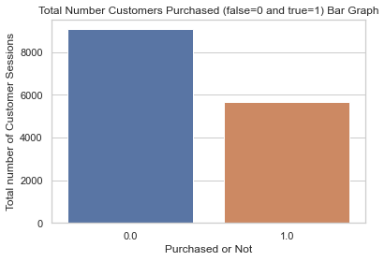
Target Variable Analysis
The ‘made_purchase’ column, serving as the target value, was encoded using Label encoding, where False was represented by 0 and True by 1.
The number of customers not purchased from the retail website is 9064 and The number of customers purchased from the retail website is 5666.
The figure indicates that the number of customers purchased from the retail website is less than the number of customers not purchased from the retail website.

Slide 12
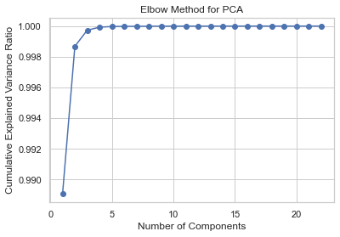
Principal Component Analysis
The dataset was split into training and testing sets using an 8.2 ratio.
To enhance the interpretability of machine learning models, feature scaling was applied to both the training and testing data. With 9 features present in the dataset, a dimensionality reduction technique such as PCA was employed. Using the elbow method, the optimal number of components for PCA was determined to be 2. However, it was observed that the accuracy decreased when compared to the original data without PCA.
We used PCA specifically because the dimensions of the input features are high (high variance)

Slide 13
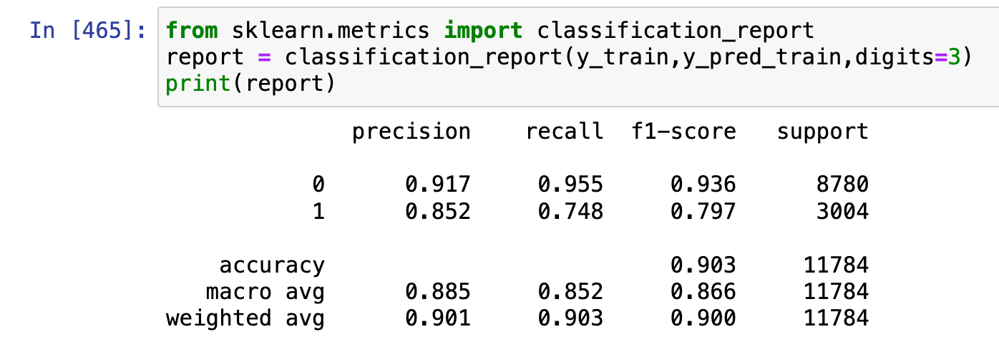
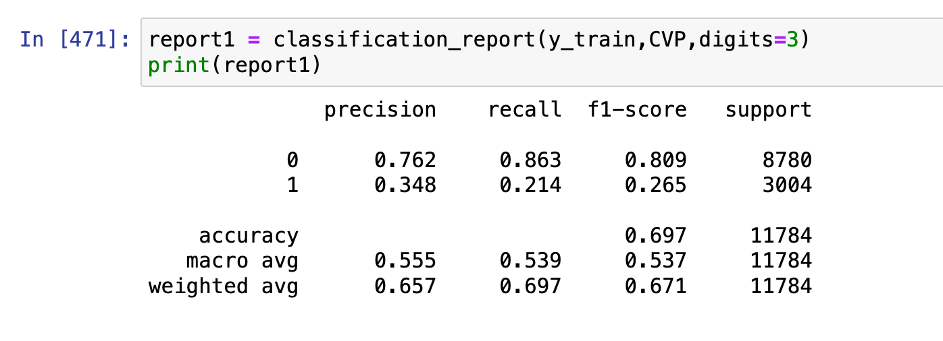
Cross Validation
To enhance the model’s performance and mitigate overfitting, cross-validation was deployed. Initially, in the Random Forest model, the training score was observed to be 0.903, while the test score stood at 0.660, indicative of overfitting. Following the implementation of 3-fold cross-validation on the Random Forest model, the training score decreased to 0.697, while the testing score remained relatively stable at 0.657. This adjustment suggests a more balanced performance and a reduction in overfitting tendencies. Similar trends were observed in other Machine Learning models.
Training Accuracy before Cross-Validation
Training Accuracy after Cross-Validation

Slide 14
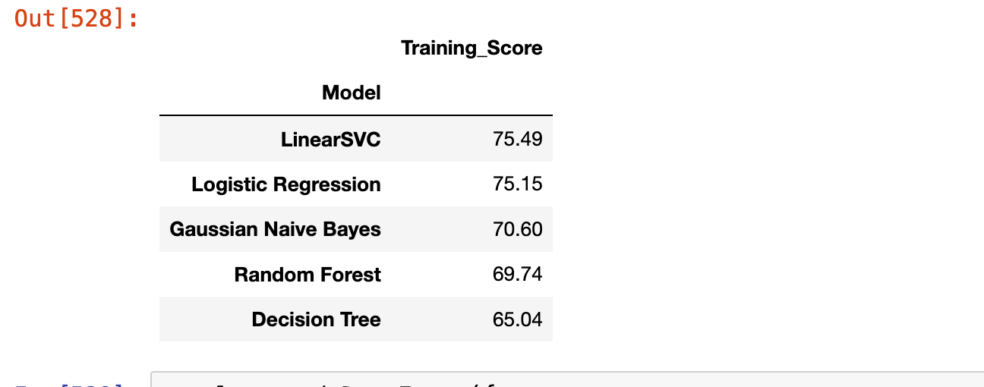
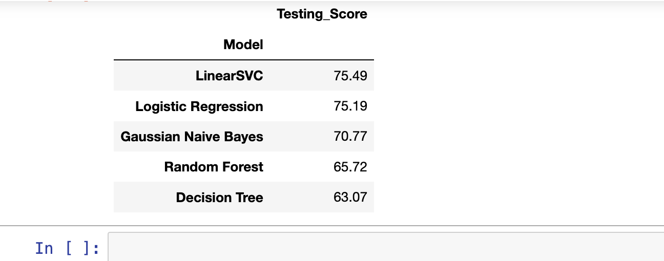
Results
The provided tables outline the training and testing scores of various machine learning models.
Notable findings include:
Training Scores:
LinearSVC and Logistic Regression achieved the highest training scores at 75.49% and 75.15% respectively.
Decision Tree achieved the lowest training score of 65.04 followed by Random Forest at 69.74%.
Testing score:
LinearSVC recorded the highest testing score of 75.49%, closely followed by Logistic Regression with 75.19 %.
Decision Tree and Random Forest models displayed the lowest testing scores, at 63.07% and 65.72%, respectively.
Overall, LinearSVC and Logistic Regression exhibited superior performance in both training and testing datasets compared to other models.

Slide 15
Conclusion
In summary, this project was conducted through exploratory data analysis (EDA) to understand consumer behaviour on a retail website, visualised insights effectively, and developed predictive machine learning models.
Key steps included handling missing values, outlier detection and treatment, feature scaling and feature selection.
Models like LinearSVC and Logistic Regration outperformed others in both training and testing datasets, offering valuable predictive capability for decision-making in the retail sector.

